Slide 1
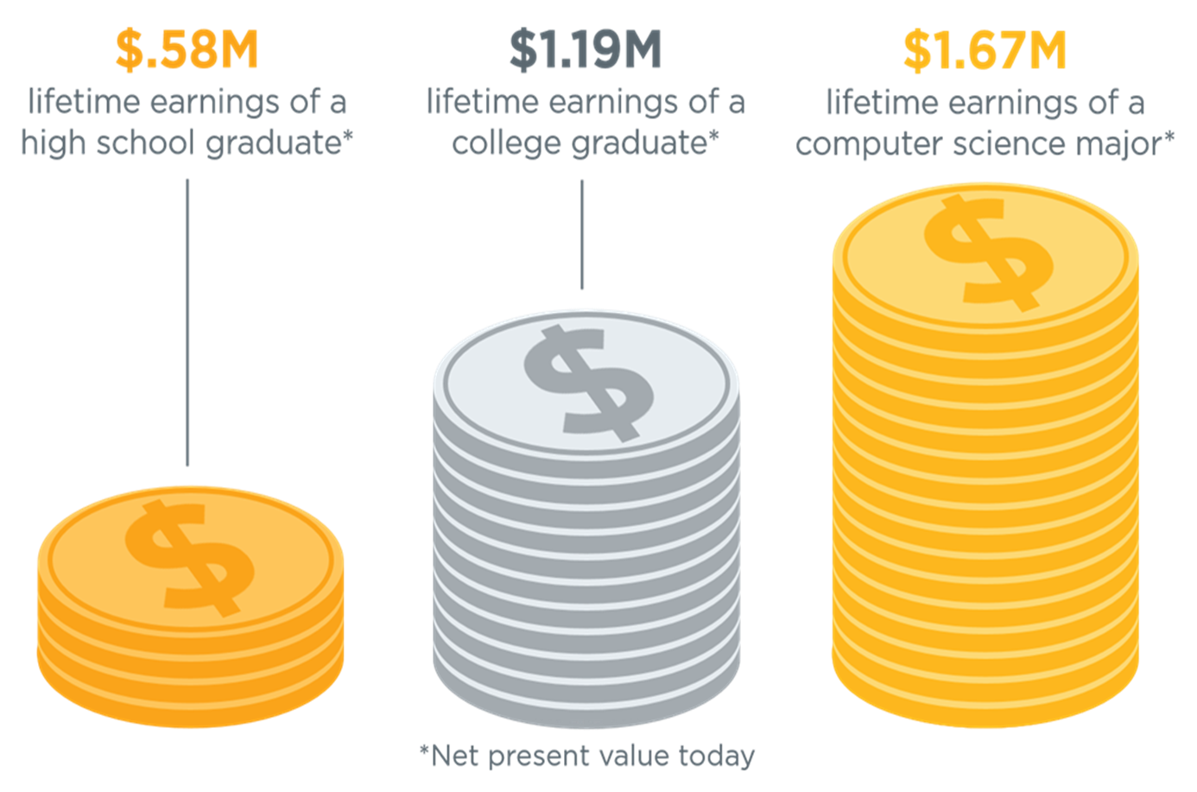
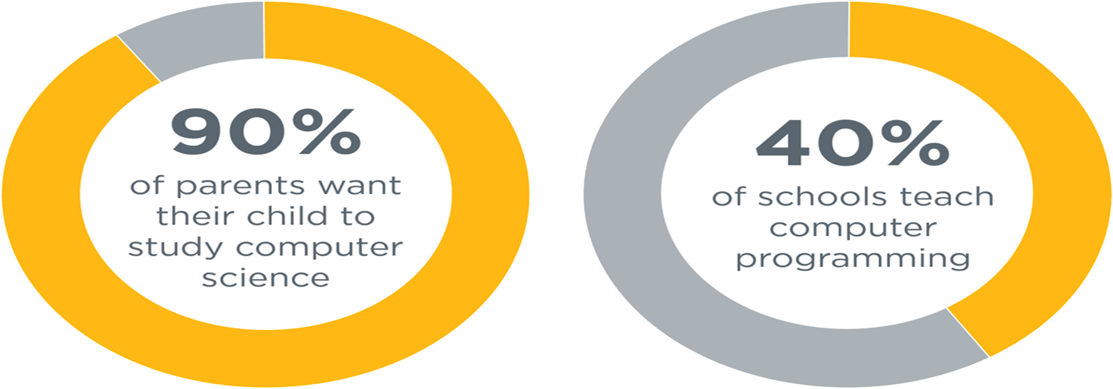
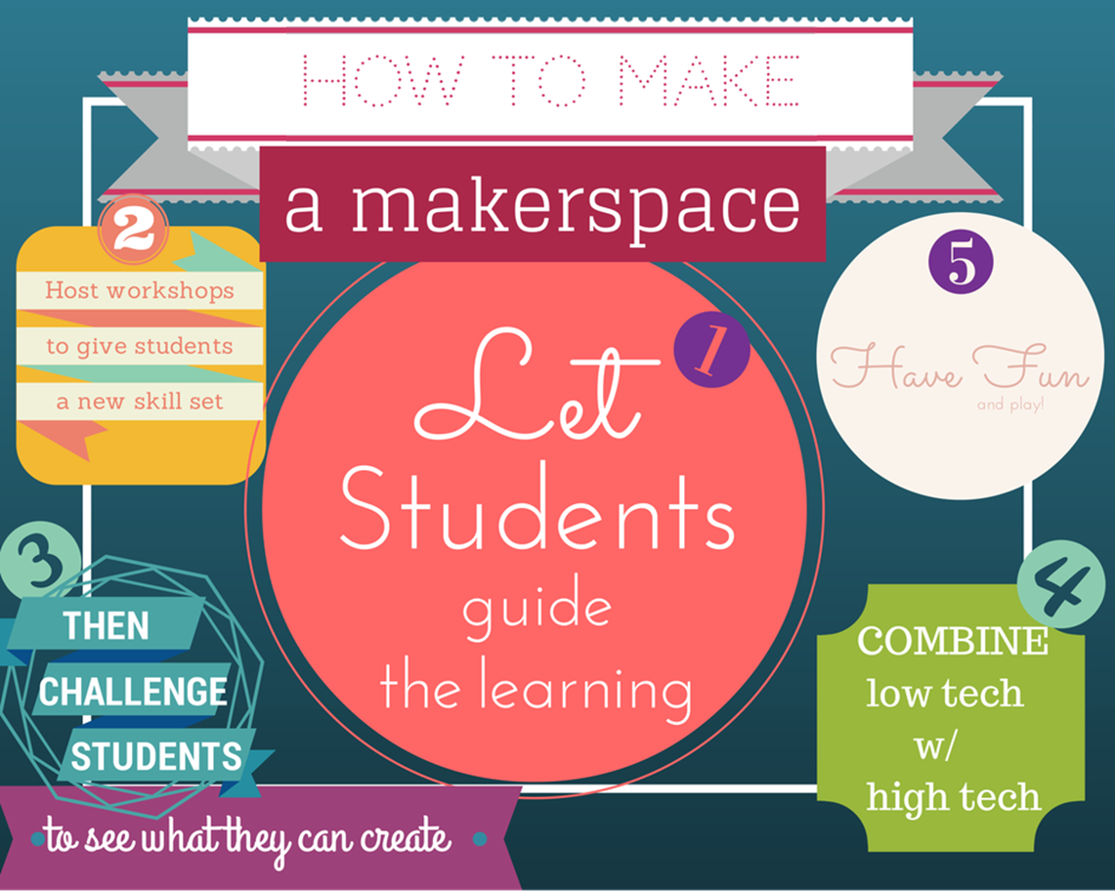
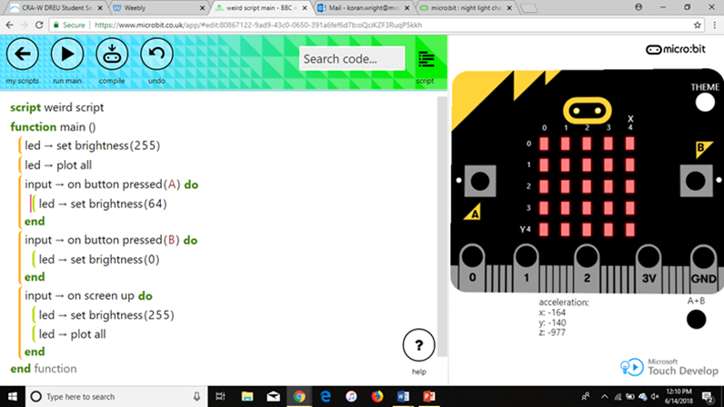
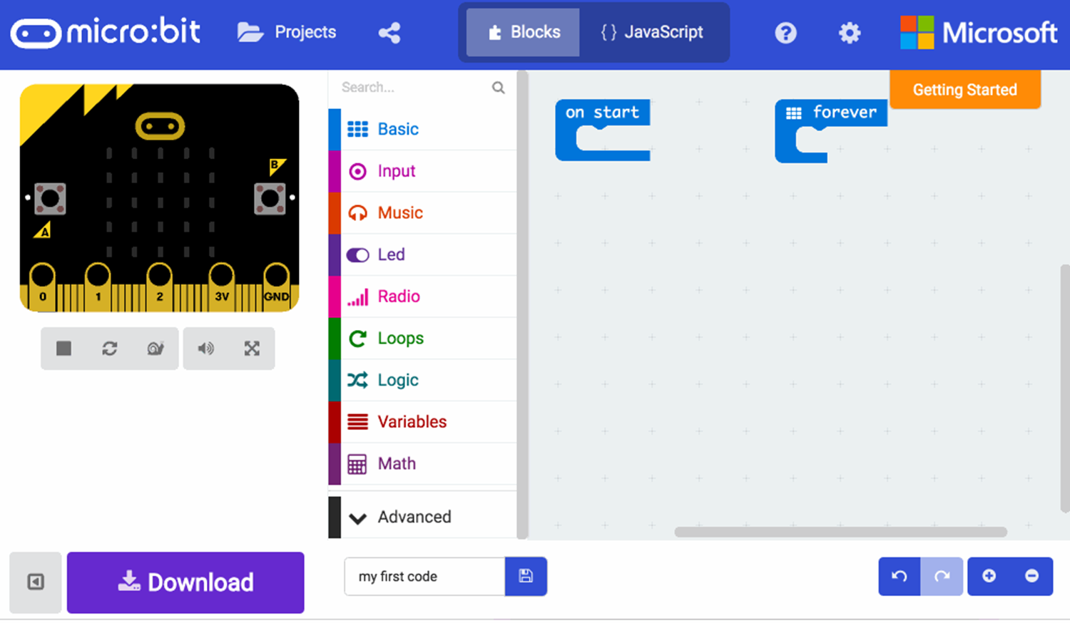
Increasing Computer Science Training to Support Future Technology Workforce
Koran Wright Arian Williams Jerrion Joy Robertson Bassy Dr. Cheryl D. Seals
MVSU MVSU ASU AU AU
abstract
Statistics
Implementation
This project stems to replicate the actions of the English who in 2013 made a national change in the curriculum for its student to focus on programming skills to solve the skills gap in the technology industry. The state of Alabama has had its own standards for computer science for K-12 grade completed by the state of Alabama in 2009. It served to evaluate the Alabama Course of Study: Technology Education. With the aid of the International Society for Technology in Education (ISTE) the groups created the standards for students in 2016. Coincide a revised version of the Computer Science Teachers Association (CSTA) with the K‐12 Computer Science Standards completed in 2017-18. Since the state currently only have standards defined but no course curriculum. AUCHIL is currently working alongside the Alabama Alliance for an Inclusive Middle Grades Computer Science Preparation through Makerspaces in the Alabama Black Belt Region. This alliance is composed of 18 other organization and academic institutions located across the state of Alabama. The objective is to create a curriculum for the state of Alabama. This will be completed by using practical teaching styles to educate students on basic programming methodology with the use of Micro bits.
We created based off the Auburn 8th grade curriculum. Lessons include.
Introduction to Design Thinking
Introduction to Micro:Bit System
Introduce algorithms and computation thinking
Strengthen their computer science and technology background for jobs in computer science field. Students can become:
Computational Thinker
Algorithms
Programming and Development
Citizen of a Digital Culture
Safety, Privacy, and Security
Impact of Computing
Global Collaborator
Creative Communications
Social Interactions
Computing Analyst
Modeling and Simulation
Innovative Designer
Human/Computer Partnerships
Design Thinking
Implement computer science into the 8th grade curriculum to enhance the knowledge of students. Also, to fulfill the promising jobs of computer science.
Introduction
Stem is changing the world. There are over one hundred thousand jobs available in the computer science field. Less than fifty thousand students graduate in computer science a year. At this rate more and more computer jobs will be available with not many computer science graduates. Jobs that pay at least eighty thousand dollars a year or more.
Computer Science can also be a major asset to everyday life. Theoretical Computer Science concepts need to be added as requirement for more students.
Methods and Tools
Methods
Build Computing Curriculum
Create Lessons & Activities to support Curriculum
Evaluate Learning Outcomes
Tools
Computing Lessons, Videos & Microbits
Makerspace
Problem
References
There was very little AP CS taught in Alabama. To solve this problem, our objective was to create a comprehensive curriculum for the state of Alabama. To achieve this objective we are creating lessons to support this curriculum, practical teaching examples to educate students on basic programming methodology with the use of Micro bits.
1. Dredge, S. (2014, September 04). Coding at school: A parent's guide to England's new computing curriculum. Retrieved from https://www.theguardian.com/technology/2014/sep/04/coding-school-computing-children-programming
2. Bureau of Labor Statistics (2015, December 01). Industry employment and output projections to 2024 : Monthly Labor Review. Retrieved from https://www.bls.gov/opub/mlr/2015/article/industry-employment-and-output-projections-to-2024.htm
3. https://code.org/advocacy/state-facts/AL.pdf

